Slide 1
Thread vs Process
System Call
Dr. Manmath N. Sahoo
Dept. of CSE, NIT Rourkela

Slide 2
Threads Vs Processes
for(i=0;i<100000;i++)
{
receive data from i/p device //RcvData()
send data on communication link //SendonLink()
}
If communication link is not free then the process will halt in line#4. Even though i/p device is free, it cant be used.
In line#3, if user has not specified any input then communication link may be underutilized.
If there is no other process available, then CPU can’t make a context switch even (at line#3)

Slide 3
Threads Vs Processes
Solution
Consider RcvData() and SendonLink() to be two different entities
RcvData(), on data availability, will put data in a queue
SendonLink(), on link availability, will send data from the queue
Whoever is free, can execute on CPU
RcvData() and SendonLink() entities can be implemented as processes or Threads

Slide 4
Threads Vs Processes
Threads are the unit of execution in a process.
A thread shares address space with it’s parent.
Per Thread items
Thread ID – Unique identifier
Program Counter – which instruc­tion to execute next
Registers – for computation
Stack – contains the execution history
State – thread state
Notes:
Thread Example:
Auto saving on word while typing
Printing a large word document and typing

Slide 5
Threads Vs Processes
Threads share the address space of the process that created it; processes have their own address space.
Threads have direct access to the data segment of its process; processes have their own copy of the data segment of the parent process.
Threads can directly communicate with other threads of its process; processes must use interprocess communication to communicate with sibling processes.
Threads have almost no overhead; processes have considerable overhead.
New threads are easily created; new processes require duplication of the parent process.
It is a light weight process and faster

Slide 6
Thread: Programmer’s View
void fn1(int arg0, int arg1, …) {…}
main() {
…
tid = CreateThread(fn1, arg0, arg1, …);
…
}
At the point CreateThread is called, execution continues in parent thread in main function, and execution starts at fn1 in the child thread, both in parallel

Slide 7
How Thread Can Help? – Example 1
Consider the following code fragment
for(k = 0; k < n; k++)
a[k] = b[k] * c[k] + d[k] * e[k];
Rewrite this code fragment as:
CreateThread(fn, 0, n/2);
CreateThread(fn, n/2, n);
fn(l, m) {
for(k = l; k < m; k++)
a[k] = b[k] * c[k] + d[k] * e[k];
}
What did we gain?

Slide 8
How Thread Can Help? – Example 2
Consider a Web server
Create a number of threads, and for each thread do
get network message from client(URL Request)
get URL data from disk
compose response
send response
What did we gain?

Slide 9
How Thread Can Help? – Example 2 Overlapping Requests (Concurrency)
Request 1
Request 2
get network message from client (URL Request)
get URL data from disk
compose response
send response
get network message from client (URL Request)
get URL data from disk
compose response
send response
Time

Slide 10
System Call
A request by an active process to the Kernel for a service
Defines the interface between the user and the OS
The process switches to Kernel mode from user mode, during a system call
Preemptive vs. non-preemptive kernel
NonPreemptive: Linux 2.4 Kernel
Preemptive: Linux 2.6 Kernel

Slide 11
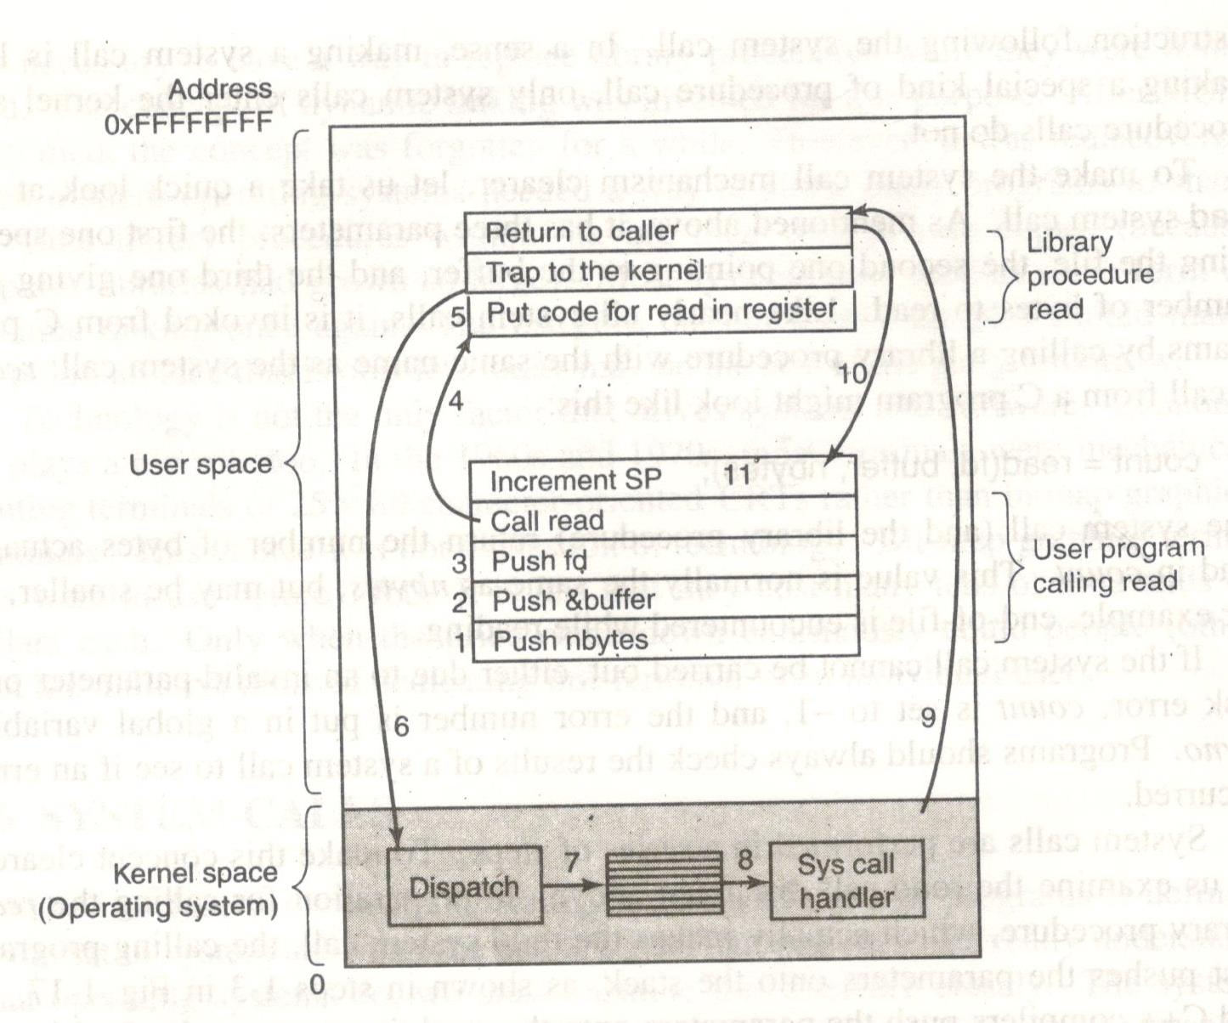
read system call

